Slide 1

Task 3 :- Data Insights
The Analytics Team
Sprocket Central Pty Ltd
Data analytics approach
Rahul C. Jadhav

Slide 2


Agenda
Objective
Project Scope
Introduction
Data Exploration
Model Development
Interpretation
Project Understanding and Data Exploration
Discuss the importance of understanding the data for accurate analysis.
Present an overview of the dataset, including its structure and variables.
Highlight the significance of data exploration in identifying missing values, outliers, and variable distributions.
Share initial findings and insights from the data exploration phase
02

Slide 3
introduction
Problem Approach for Identifying and Recommending Top 1000 Customers to Target from dataset:
Problem Overview:
Data Analysis Contents:
Sprocket Central is a company that specializes in high-quality bikes and cycling accessories.
The marketing team wants to increase business sales by analyzing provided datasets.
The goal is to analyze the data and recommend 1000 customers that Sprocket Central should target to drive higher value for the company.
Understanding the age distributions of "new" and "old" customers.
Analyzing bike-related purchases over the last 3 years based on gender.
Examining the distributions of customers across different job industries.
Segmenting customers by wealth categories and age groups.
Investigating the number of cars owned and not owned by customers in each state.
Conducting RFM analysis and classifying customers into different categories.
This will be done with the three phases of: Data Exploration,
Model Development, and Interpretation.
03

Slide 4
Data Exploration
Data Quality Assessment and 'Clean Up'
Key Issues for Data Quality Assessment
Accuracy: Problem - Errors in DOB and missing age/profit columns;
Solution - Filter incorrect DOB values, create age column, and add profit column.
Completeness: Problem - Inconsistent customer IDs and blank entries;
Solution - Filter blanks, ensure consistent IDs.
Consistency: Problem - Inconsistent gender and state names;
Solution - Filter and standardize names for consistency.
Relevance: Problem - Irrelevant/incomprehensible columns;
Solution - Remove irrelevant columns.
Validity: Problem - Non-standardized formats;
Solution - Format dates and prices for consistency and accuracy.
An in-depth analysis has been sent via email.
05

Slide 5
Data Exploration
'New' and 'Old' Customer Age Distributions
Most customers are aged between 40-49 in 'New.' In 'Old' majority of customers are aged between 40-49 also.
The lowest age groups are under 30 in ‘New’ and 80+ for both 'New' and 'Old' customer lists
The 'New' customer list suggests that age groups 30 and 50-69 are most populated.
The 'Old' customer list suggests 40-59.
There is a steep drop of customers in the 30-40 age group in 'New.'
06

Slide 6
Data Exploration
Bike related purchases over last 3 years by gender
Over the last three years about 50% of bike related purchases were made by females to 48% of purchases made by males. Approximately 2% were made by unknown gender
Numerically, females purchases almost 10 000 more than males
Females make up majority of bike related sales
07

Slide 7
Data Exploration
Job Industry Distribution
20% of 'New' Customers are in Manufacturing and Financial Services.
The smallest number of customers are in Agriculture and Telecommunications at 3%
the pattern in ‘new' customer list,higher and lower at -1% and 2% in Manufacturing and Financial Services respectively
08

Slide 8
Data Exploration
Wealth Segmentation by age category
In all age categories the largest number of customers are classified as 'Mass Customer'
The next category is the 'High Net Worth' customers.
The 'Affluent Customer' can outperforms the 'High Net Worth' customer in the 40-49 age group.
09

Slide 9
Model devlopment
Number of cars owned and not owned by
NSW has the largest amount of people that do not own a car. NSW seems to have a higher number of people from which data was collected.
Victoria is also split quite evenly. But both numbers are significantly lower than those of NSW.
QLD has a relatively high number of customers that own a car.
10

Slide 10
Model devlopment
RFM segmentation ( recency, frequency, monitory)
The majority of customers fall into the 'silver' category with a count of 1009.
The 'gold' category has the second highest number of customers with a count of 815.
There are 793 customers in the 'diamond' category, indicating a relatively smaller customer segment.
The 'platinum' category has a count of 877, placing it between the 'gold' and 'silver' categories.
Overall, the 'silver' and 'gold' categories have a higher number of customers compared to the 'diamond' and 'platinum' categories.
11

Slide 11
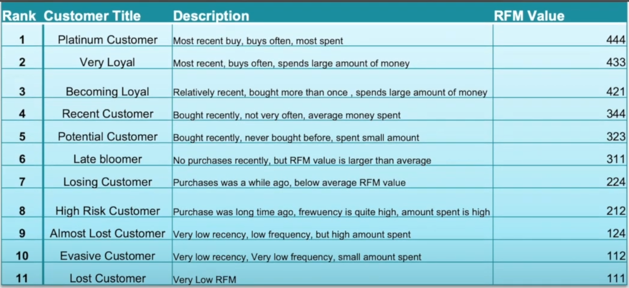
Interpretation
12

Slide 12
Task 3 :- Data Insights
Sprocket Central Pty Ltd
Thank you

